Slide 1
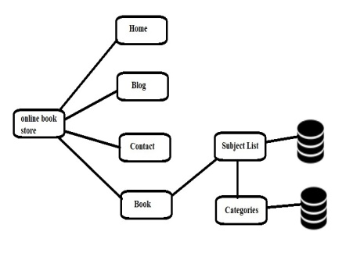
Online Book Store
Department of computer engineering, Theem College of Engineering,Mumbai university
INTRODUCTION
This project Online Book Store has been developed on PYTHON using Django HTML and sql.The main objective for developing this project was to sell book online. This project intends different types of forms with many types of book but on my online site you will find all semester books of Mumbai University. It helps to buy, sell books online by internet connection. It can manage purchasing of book online, customer can choose many types of books categories, online payments, delivery service etc. This project provides a lot of features to manage in very well manner, This project contains a lot of advance modules which makes the back end system very powerful.
The Online Bookstore Project is the project through which one will be able to buy and sell the books through online mode. People will be very lazy to go the book store to buy that book. It will also help in saving the time, energy etc. It will be also useful for the small vendors to sell their books online and make more profit out of it. You will be able to buy the books at anytime from anywhere.
It can also help in the improvement of the business of small book vendors to sell their books at ease.
METHOD/working
RESULTS
Images
TIFFs are the preferred file format for images appearing in printed posters. Avoid the use of low-resolution jpgs, especially those downloaded from the Internet, as they will reproduce poorly.
In order to insert an image, use the menu toolbar at the top of your screen.
Select:
1 Insert
2 Picture
3 From file
4 Find and select the correct file on your computer
5 Press OK
Be aware of the image size you are importing.
ARCHITECTURE
Fig provides the full view on the system flow of the online books catalog. As demonstrated, users are exposed to five (4) different links which are the main functions of this website through the home page.
Captions set in a serif style font such as Times, 18 to 24 size, italic style.
Duis autem vel eum iriure dolor in hendrerit in vulputate velit esse molestie consequat.
ABTRACT
An online bookstore software projects that acts as a central database containing various books in stock along with their title, author and cost. This project is a website that acts as a central book store. The sql database stores various book related details. A user visiting the website can see a wide range of books arranged in respective categories. The user may select desired book and view its price.Once the user selects a book , he then has to fill in a form and the book is booked for the user.
The business-to-consumer aspect of electronic commerce is the most visible business use of the World Wide Web. The primary goal of an e-commerce site is to sell goods and services online. This project deals with developing an e-commerce website for Online Book Sale. It provides the user with a catalog of different books available for purchase in the store. In order to facilitate online purchase a shopping cart is provided to the user. In order to develop an e-commerce website, a number of Technologies must be studied and understood. These include multi-tiered architecture, server and client side scripting techniques, implementation technologies such as PHP, programming language (such as JavaScript, and HTML), relational databases (such as SQL, Access). This is a project with the objective to develop a basic website where a consumer is provided with a shopping cart application and also to know about the technologies used to develop such an application. This document will discuss each of the underlying technologies to create and implement an e-book store.
CONCLUSIONS
Basic functionalities of this website are book search, shopping cart and bookstore personnel administration area which includes subject name, authers name.
This research project could be extended so that in the future the lecturers and students could purchase the books online. The concept of the e-commerce and security need to be apply in order to make sure that the system is secured while they are doing the transaction.
Web prototype gives a basic idea of how the outcome design of Online Bookstore will look like, based on the research being done. It acts as a guide for developers to create an integrated web platform suited to user’s requirement, userfriendly and most important, its functionality.
Hence Online bookstores has existed and being utilized
Captions set in a serif style font such as Times, 18 to 24 size, italic style.
Duis autem vel eum iriure dolor in hendrerit in vulputate velit esse molestie consequat.
Captions set in a serif style font such as Times, 18 to 24 size, italic style.
Duis autem vel eum iriure dolor in hendrerit in vulputate velit esse molestie consequat.

